Slide 1
Environmental Data Science
Lecture 1
Course Introduction, Intro to R and R Studio

Slide 2
By the End of the Quarter:
Be familiar and comfortable with the R scientific computing environment and basic programming concepts
Be able to perform essential data science tasks such as data processing, data exploration, and visualization / graphing
Have familiarity with statistical concepts such as multi-variate regression and inference, with applications to problems in environmental science and policy
Be knowledgeable about more advanced tools and packages available for data science in R: geo-spatial data analysis, machine learning, cloud computing etc

Slide 3
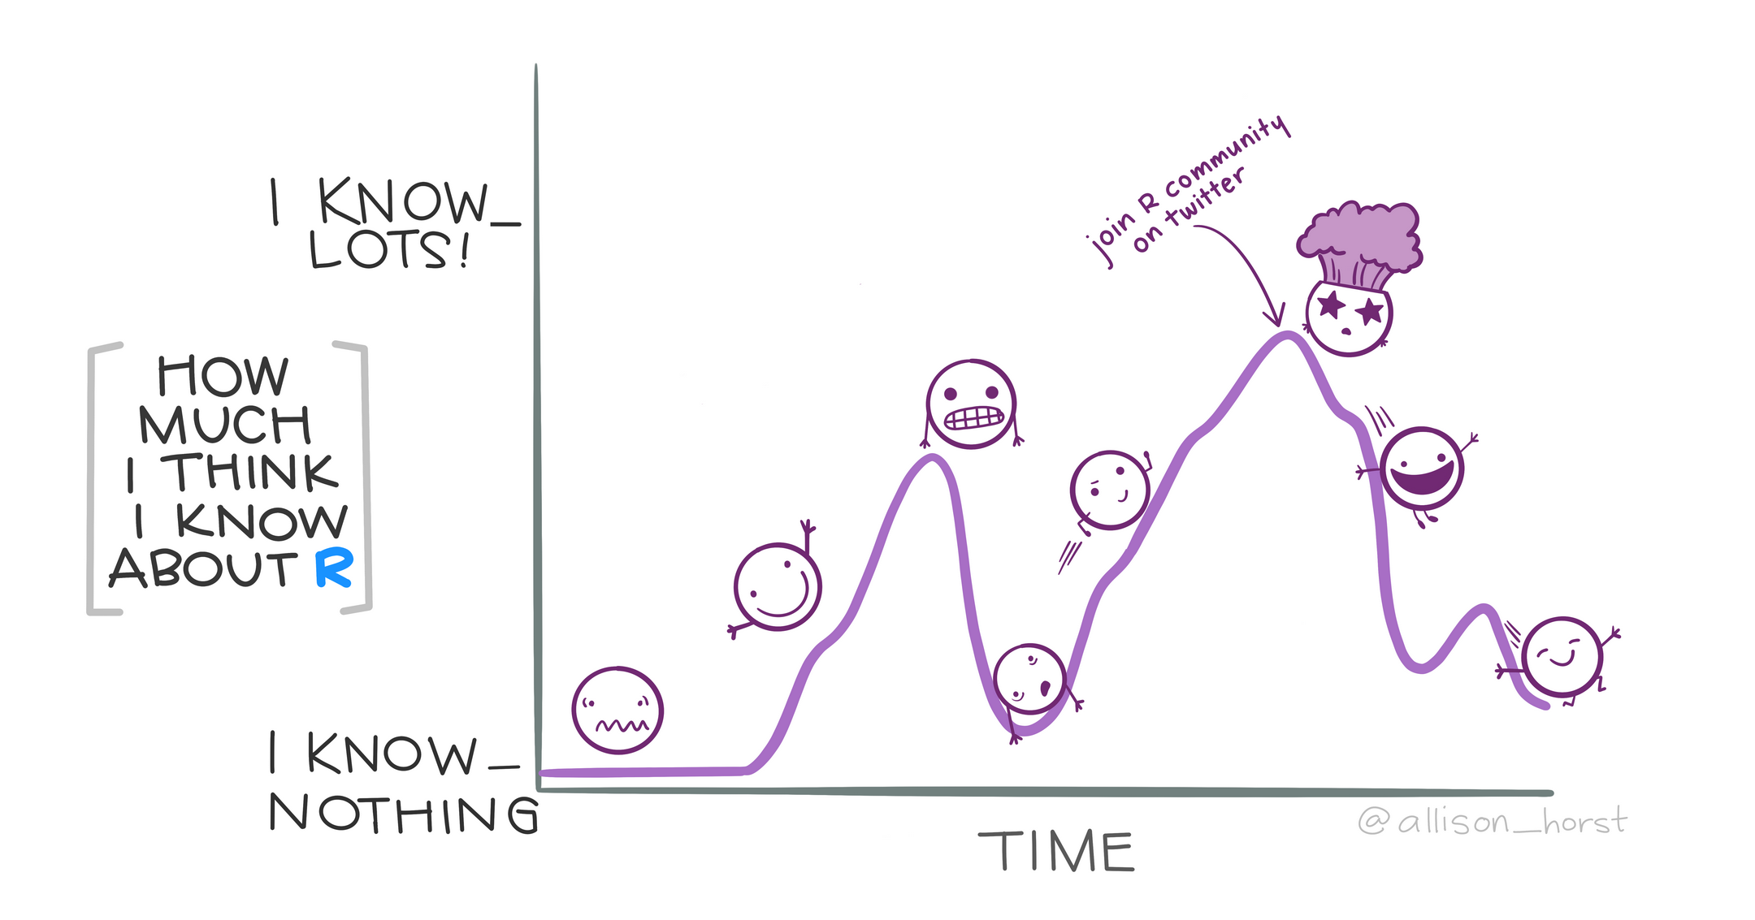
Course Philosophy
This is intended for people with no prior experience in programming – we will start from the very beginning and not assume you know anything!
There is no such thing is a silly question!
Think of this as a learning a language more than a science class:
Practice Practice Practice
Expect to be frustrated (particularly early on)
There is often more than one way of doing things
R Knowledge Rollercoaster by Allison Horst

Slide 4
Why R?
Learning R involves an investment of time. So why do it?
Very widely used, open-source (free!) programming language. Commonly and increasingly used in many branches of science (e.g. ecology) and social science (e.g. economics)
Top-quality packages for statistical modeling (e.g. regression), spatial data analysis, visualization and mapping, machine learning and big-data analysis, web-integration. Continuing innovations and developments.
Learning one programming language makes it much (much!) easier to learn others later on if you need to (Python, Matlab, Stata, Julia etc)

Slide 5
Some Cool Examples
Fran’s Climate Model on RShiny:
https://fmoore125.shinyapps.io/climate-social-model/
Arianna’s police funding map: https://aestokes.github.io/

Slide 6
Course Overview
Lectures: 10-10:50 Monday and Wednesday
Labs: 1-4pm Monday and Wednesday
Like extended office hours – instructors will be available to troubleshoot / help with labs
Labs are intended to be completed within this amount of time (i.e no “homework” outside of lab time)
Working on labs during this time when instructors are available to help is highly encouraged

Slide 7
Course Overview
Content and assignments: Syllabus….

Slide 8
Computer / Software Requirements
You will need to have current versions of R and R-Studio installed.
Instructions are here:
https://rspatial.org/intr/1-introduction.html#installing-the-r-and-r-studio-software

Slide 9
Introduction to R, RStudio and Basic Data Types

Slide 10
(Most) Computer Languages (including R) have:
Defined basic data types (e.g. numbers, vectors, matrices)
Arithmetic (add, subtract, multiply, divide)
Conditional loops (for, while)
Branch (if, else)
Ability to reuse code (i.e. functions)
File input / output
Library of common functions
Allow creation of complex data types

Slide 11
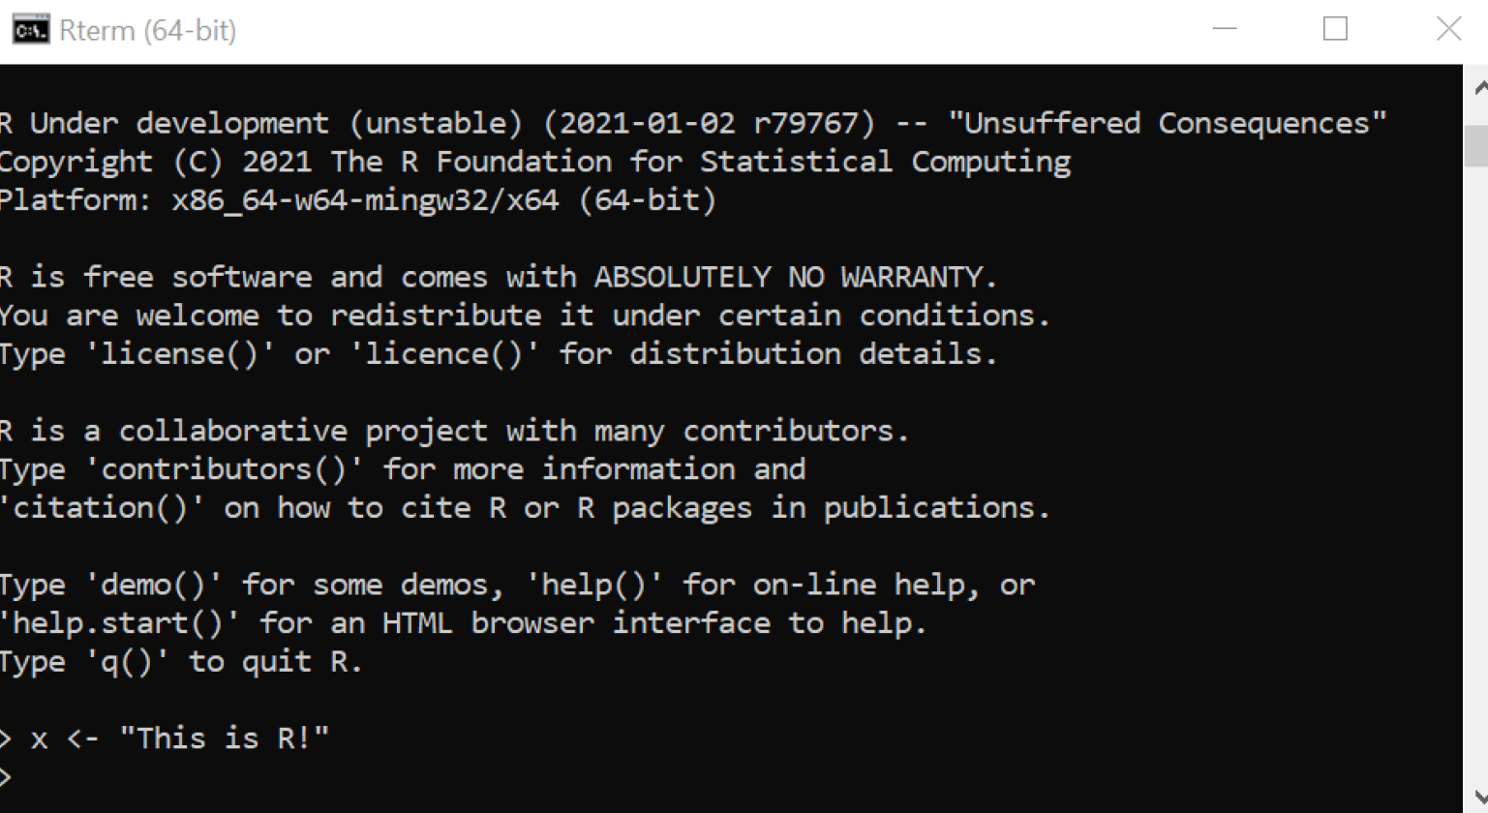
Ways of Interacting with R:
Computer command line (most basic)

Slide 12
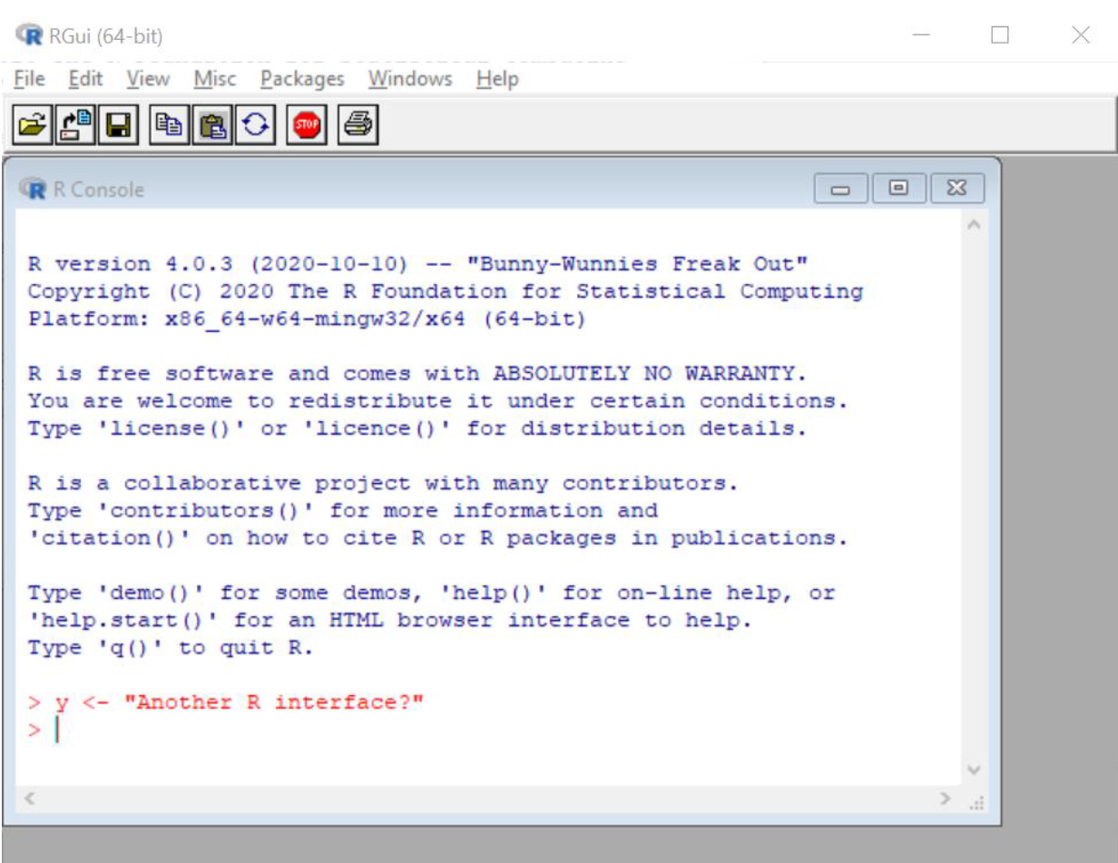
Ways of Interacting with R:
R GUI (graphical user interface):

Slide 13
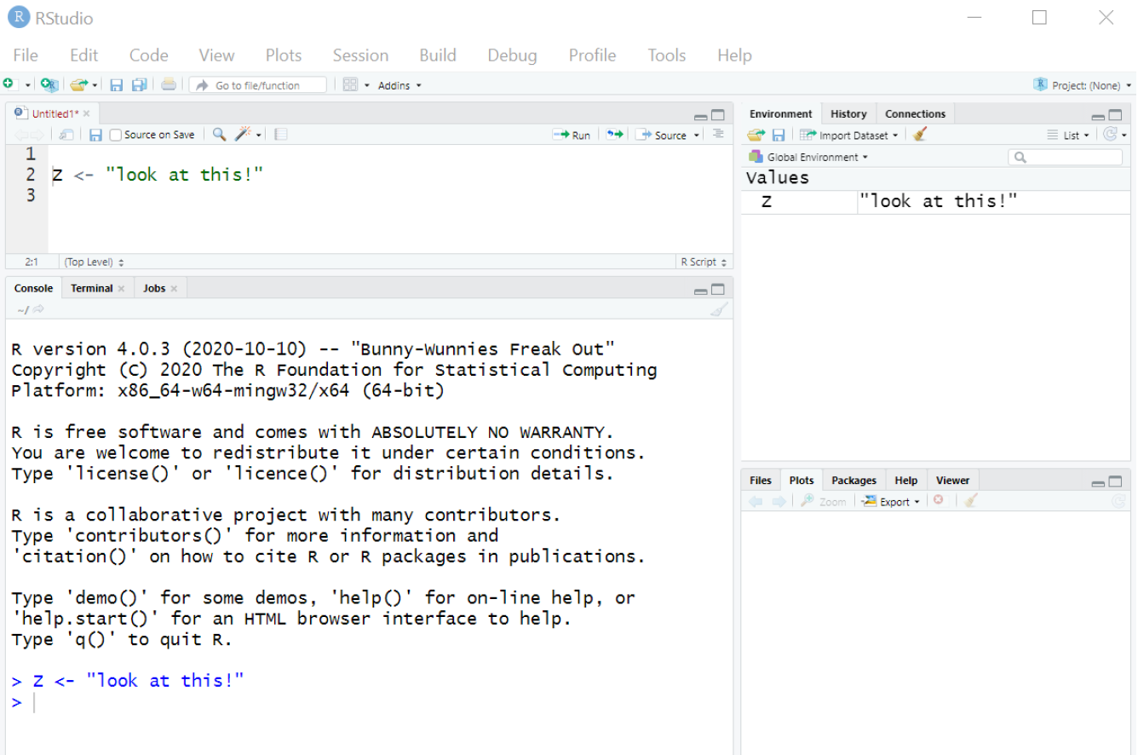
Ways of Interacting with R:
Tells you objects currently stored in the environment
R Studio (integrated development environment):
R “script” – where you write / edit the code you want to run
R “console” – where the code actually runs
Various useful things e.g plots, R help, file explorer

Slide 14
Basic Data Types in R
Numeric: numbers e.g. 67.9
Integer: whole numbers e.g. 68
Character: words or letters e.g. “hello” – use quotation marks in R to define characters
Factor: categorical labels e.g. data on eye color might be a factor with labels such as brown, blue, green etc.

Slide 15
Basic Data Types in R
Vector: a one-dimensional set of multiple values (could be numerics, integers, characters).
Use “c” (for ‘combine’) to create them in R
Separate values using commas
E.g. c(3,9,10,11) – a vector of length 4 consisting of the numbers 3,9,10 and 11
Matrix: a two-dimensional set of values arranged into a rectangle (rows and columns)
use matrix() function to create a matrix, or cbind() function to join together vectors of the same length into a matrix

Slide 16
Assigning Variables in R
When you first open R / RStudio, the environment is empty – nothing exists yet
In order to start doing anything, usually you will begin assigning names to certain objects
Use “=“ or “<-” to assign values to objects
e.g. x=59 – creates a numeric named “x” with the value 59
e.g. a=c(“hello”, “bean”, “doggy”) – creates a vector named “a” of length 3 with the characters “hello”, “bean” and “doggy”
The names you chose to use (e.g. “x”, “a”, “mydata” etc) become “variables” i.e. they are names that stand in for actual values and can take on variable numerical values
R is case sensitive so that "object" and "Object" are not the same thing

Slide 17
Indexing Objects in R
Vectors and matrices are made up of multiple values. Often we want to reference or access a single value out of the set in the vector / matrix – this is called “indexing into” the object
R uses [] notation for indexing.
Vectors are one dimensional so just use one value – e.g. a[8] means the 8th value in the vector a
Matrices are two-dimensional so use two values to index a single value within a matrix, separated by commas. The first value gives the row number and the second value the column number – e.g. b[1,5] means the value in the 1st row and 5th column of the matrix b
For matrices if you leave either the row number of column number blank, R will give you that whole row / column – e.g. b[,4] means the 4th column of the matrix b; b[3,] means the 3rd row of the matrix b

Slide 18

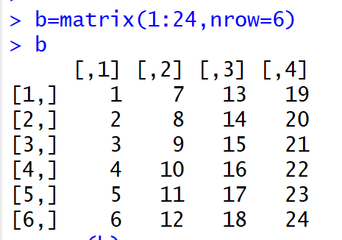

Slide 19


Slide 20


Slide 21
(Slightly) More Complex Data Types
Data Frame: A set of columns of data
Rectangular, two-dimensional data type (like a matrix) but columns can be of different data types (e.g. one column is a vector of characters, another column is a factor)
Has column names that can be used to reference data – e.g. d$eye_color might give the column named “eye_color” in the data frame d
Usually rows are meaningful in some way (i.e. all entries in row 5 are data referring to the same individual)

Slide 22
(Slightly) More Complex Data Types
List: Flexible way of storing data of arbitrary types and size
Like a data frame, list objects can be of different data types (e.g. numeric, character). But in a data frame each column has to be a vector of the same length. In a list, objects can be of arbitrary dimensions (e.g. a 4*8 matrix, a single number, a data frame could all be elements in the same list)
Index into a list using the special double square brackets [[]] notation e.g. h[[9]] is the 9th element of the list h
Like column names in a data frame, list elements can be named and can be referenced using the name and the “$” notation e.g. h$height_data is the element named “height_data” in the list h

Slide 23
Lab for Monday Afternoon
Read through “Basic Data Types” and “Basic Data Structures” at https://rspatial.org/intr/index.html
Complete the first half of the week one lab practicing using different data types in R and assigning variables
After class on Wednesday, complete the rest of the lab practicing indexing and reading files, based on “Indexing”, “Algebra”, “Read and Write Files” and “Data Exploration” section at https://rspatial.org/intr/index.html
Upload your R file to Canvas by end of the week

